Slide 1
Unit –1 Introduction to System Programming
DPU
Dr. D. Y. Patil Institute of Technology , Pimpri Pune
Computer Engineering Department
By
Prof. Adsure Sharad S.

Slide 2
CONTENTS :-
^{Introduction}
^{Components of Software System}
^{Text editor}
^{Loader}
^{Assembler}
^{Macroprocessor}
^{Compiler}
^{Debugger}
^{Machine Structure}
^{Machine Language}
^{Assembly Language}
Assemblers : General design procedure
^{Design of assembler}

Slide 3
Introduction
What is System?
System is the collection of various components.
Ex:- College is a system
What is Programming?
Art of designing and implementing the programs.
Software is collection of many programs. Two types of software:
1. System software-
These programs assist general use application programs.
Ex:- Operating System , Assembler etc.
2. Application software-
These are the software developed for the specific goal.
System programming involves designing and writing computer programs that allow the computer hardware to interface with the programmer and the user, leading to the effective execution of application software on the computer system. Typical system programs include the operating system and firmware, programming tools such as compilers, assemblers, I/O routines, interpreters, scheduler, loaders and linkers as well as the runtime libraries of the computer programming languages

Slide 4

“INTRODUCTION OF SP”
.

Slide 5

Need Of System Software
The basic need of system software is to achieve the following goals :-
To achieve efficient performance of the system
To make effective execution of general user program
To make effective utilization of human resources
To make available new, better facilities

Slide 6


Operating System
It is the collection of system programs which acts as an interface between user and the computer and computer hardware.
The purpose of an operating system is to provide an environment in which A user can execute programs in a convenient manner
1) Single User Operating system
An operating system that allows a single person to use or access a computer at a time is called single user operating system. For example, DOS and Windows 95 are single user operating systems.
2) Multiuser Operating System
An operating system that allows more than one user to access a computer at a time is called multi user operating system. For example Unix, Linux, Windows 2000 server
3)Single Tasking operating system
An operating system that allows the user to perform only one task at a time is called single tasking operating system. For example, DOS is a single tasking operating system.
4) Multi Tasking operating system
An operating system that allows the user to perform more than one tasks at a time is called multi tasking operating system. For example Windows, Unix, Linux are multi tasking operating systems.
5) Network operating system
An operating system that supports network is called network operating system. It normally works on a server. examples of network operating system are Windows NT Server, Windows 2000 Server, UNIX, and Linux.
6) Real Time operating system
A real time operating system is a very fast operating system. It responds to a certain input extremely quickly. Example:-Air Traffic Control Systems,

Slide 7



Functions of Operating System
^{File handling and management.}
Storage management (Memory management).
Device scheduling and management.
^{CPU scheduling.}
^{Information management.}
^{Process control (management).}
^{Error handling}
Protecting itself from user & protecting user from other users.

Slide 8

Editor
Line editors
Screen editors
Word processors
Structure editors
An interactive editor is a computer program that allows a user to create and revise a target document
Document includes objects such as computer diagrams, text, equations tables, diagrams, line art, and photographs.
In text editors, character strings are the primary elements of the target text.
Editing phase involves – insert, delete, replace, move, copy, cut, paste, etc…
Document-editing process in an interactive user-computer dialogue has four tasks:
Select the part of the target document to be viewed and manipulated
Determine how to format this view on-line and how to display it
Specify and execute operations that modify the target document
Update the view appropriately

Slide 9
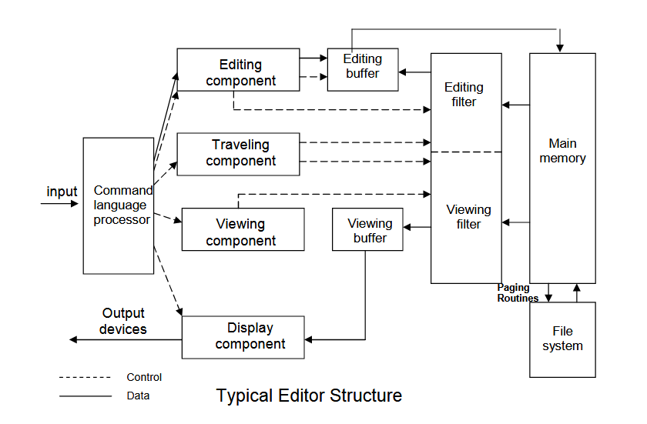

Slide 10
Command language Processor accepts command, uses semantic routines – performs functions such as editing and viewing
The semantic routines involve traveling, editing, viewing and display functions.
Editing operations are specified explicitly by the user
Display operations are specified implicitly by the editor
Traveling and viewing operations may be invoked either explicitly by the user or implicitly by the editing operations
In editing a document, the start of the area to be edited is determined by the current editing pointer maintained by the editing component
Editing component is a collection of modules dealing with editing tasks
Current editing pointer can be set or reset due to next paragraph, next screen, cut paragraph, paste paragraph etc.

Slide 11
When editing command is issued, Editing component invokes the editing filter
generates a new editing buffer Contains part of the document to be edited from current editing pointer.
Filtering and editing may be interleaved, with no explicit editor buffer being created.
In viewing a document, The start of the area to be viewed is determined by the current viewing pointer maintained by the viewing component.
Viewing component is a collection of modules responsible for determining the next view.
Current viewing pointer can be set or reset as a result of previous editing operation.

Slide 12

Translators
These are the system programs that converts the source program into computer understandable fashion
Types of translators
Single Pass translator
Multi Pass translator

Slide 13
Translators
Assembler:-
These are the system programs which will automatically translate the assembly language program in to the machine language program
Source program Assembly Lang. Prog.
Target program / M/C Lang. Prog.
Assembler
Database

Slide 14
Translators
Complier:-
These are the system programs which will automatically translate the High level language program in to the machine language program
Source program High level Lang. Prog.
Target program / M/C Lang. Prog.
Compiler
Database

Slide 15
Translators
Cross Assembler:-
These are the system programs which will automatically translate the Assembly Language program compatible with M/C A, in to the machine language program compatible with M/C A
Source program Assembly Lang. Prog. Compatible with M/C A
Target program / M/C Lang. Prog. Compatible with M/C A
Cross Assembler
M/C B

Slide 16
Translators
Cross Compiler:-
These are the system programs which will automatically translate the HLL program compatible with M/C A, in to the machine language program compatible with M/C A , but the underlying M/C is M/C B
Interpreter
– It is the language translator which execute source program line by line with out translating them into machine language.
Source program HLL Prog.
Compatible with M/C A
Target program / M/C Lang. Prog.
Cross Compiler
M/C B

Slide 17
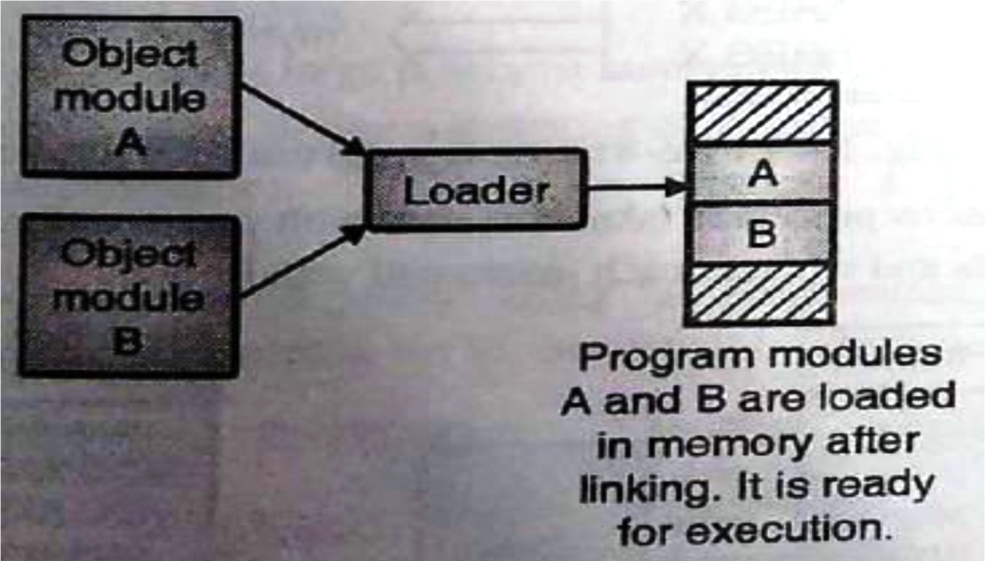
Loader
A Loader is system program that place the object program into main memory and prepares it for execution.
Basic functions of loader
Allocation
Linking
Relocation
Loading
Types of Loader
Compile-and-go Loader
Relocating Loader
Direct Linking Loader
Absolute Loader
General Loader
Dynamic Loader

Slide 18
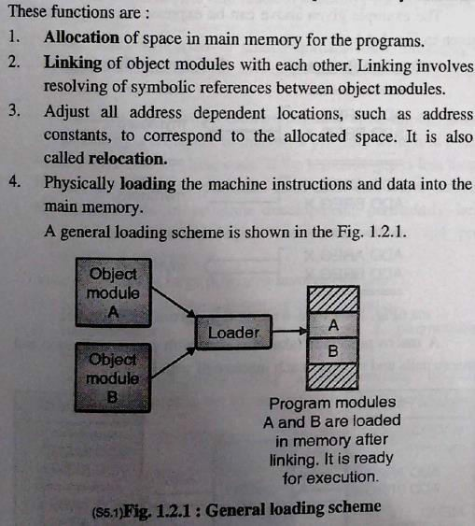
Basic function of loader
• .

Slide 19
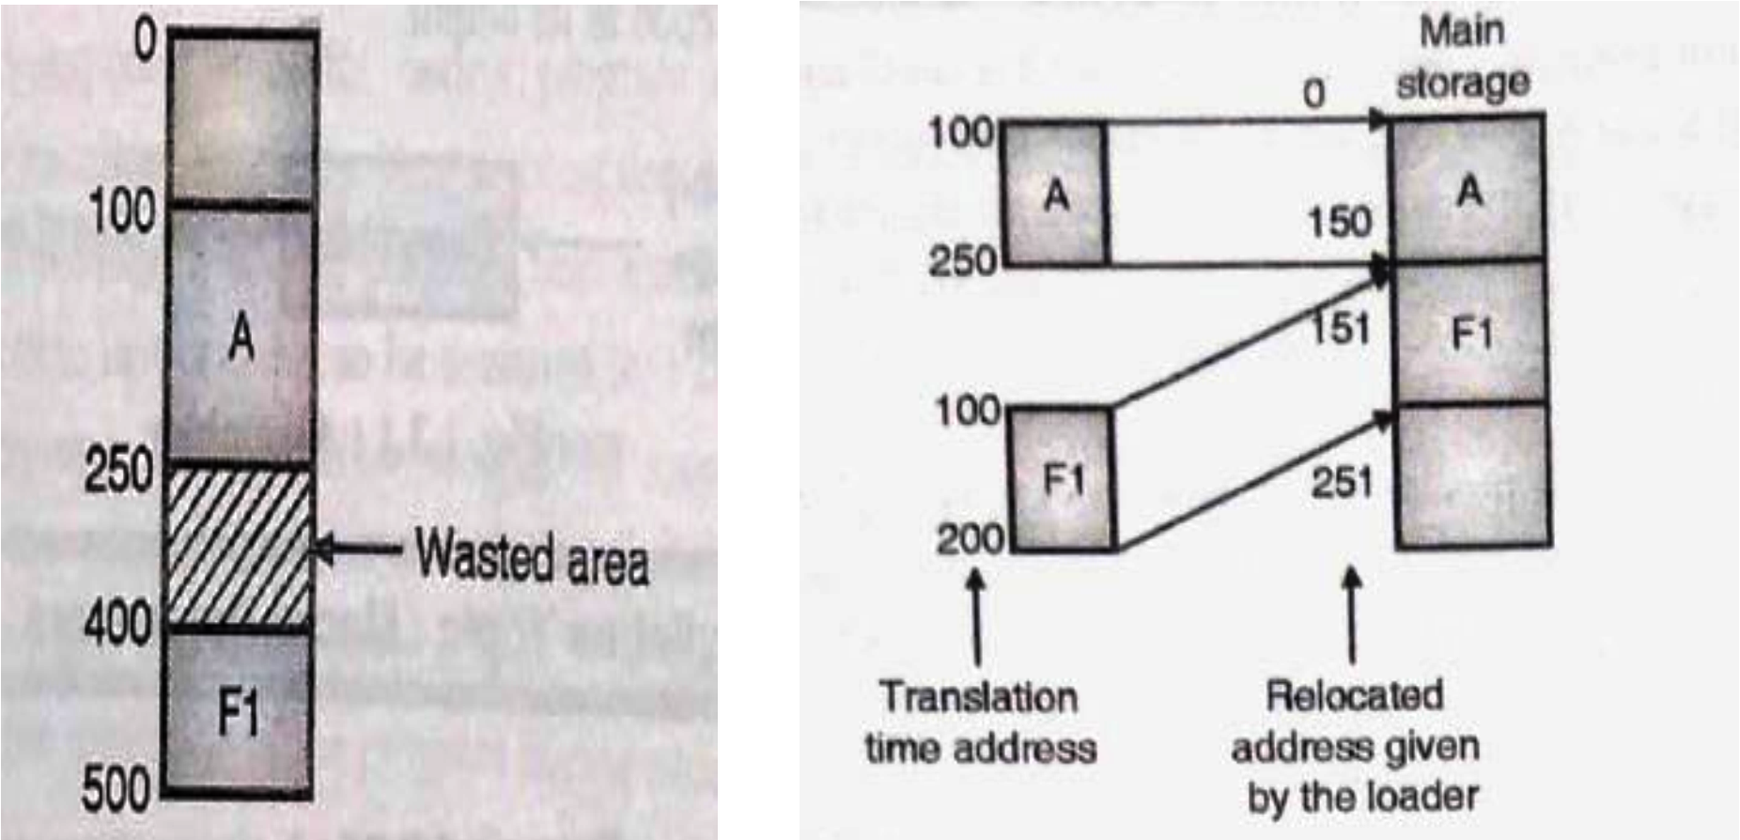
RELOCATION

Slide 20

Macro & Macro processor
Macro
– Macro is a single line abbreviation for a group of instruction.
--------Start of definition
-------- Macro name
Sequence of instructions to be abbreviated.
MACRO INCR
A 1,DATA
A 2,DATA A 3,DATA
MEND
-------- End of definition

Slide 21
Linking and Linker
Linking
– The Process of merging many object modules to form a single object program is called as linking.
Linker
The Linker is the software program which binds many object modules to make a single object program.

Slide 22
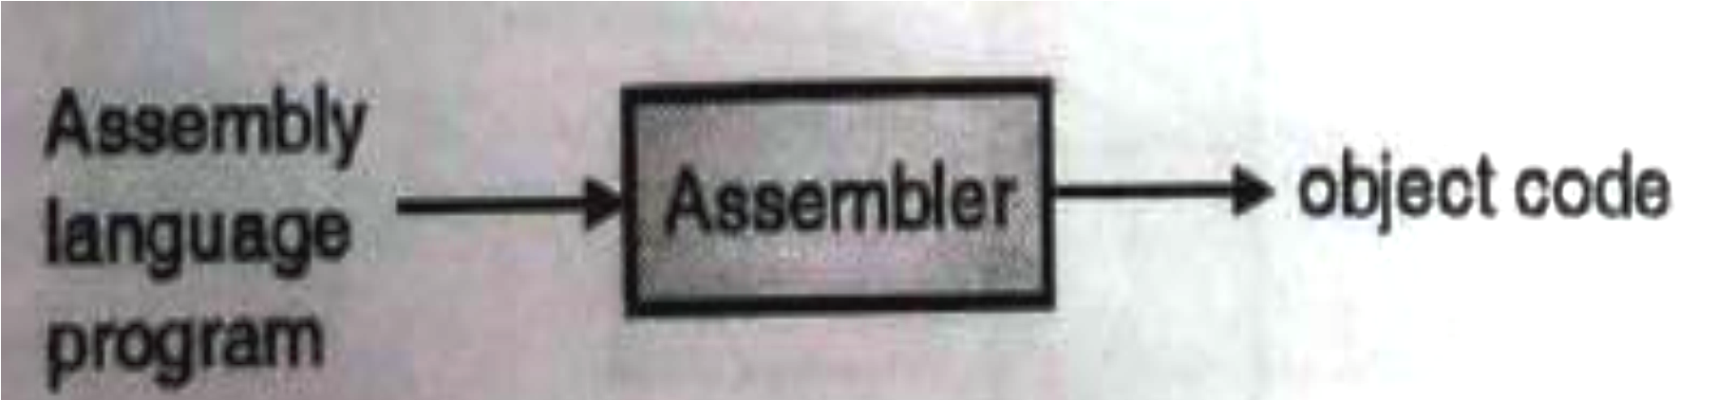
ASSEMBLY LANGUAGE PROGRAMMING

Slide 23
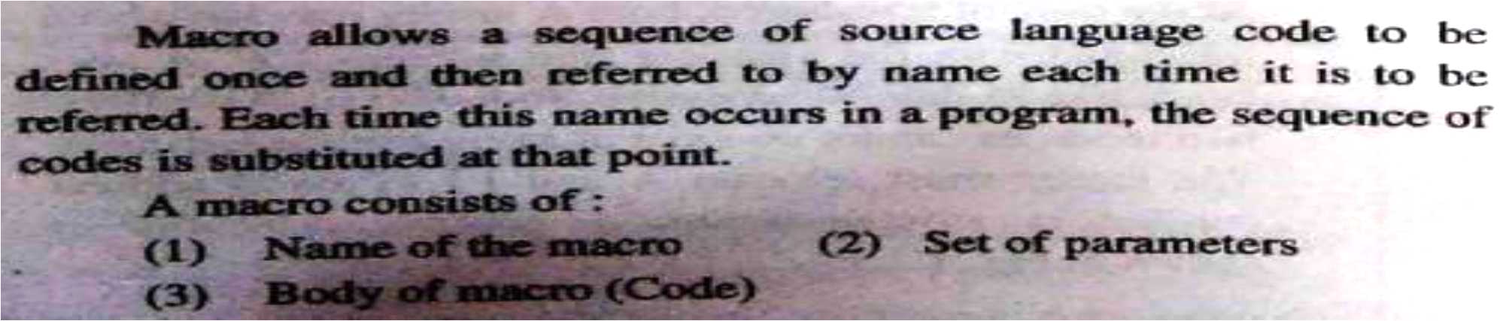
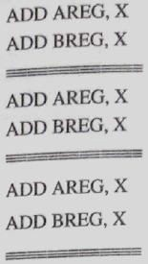
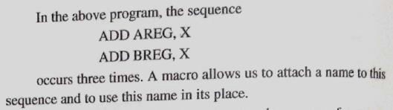
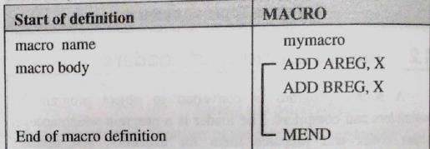
MACROPROCESSOR

Slide 24
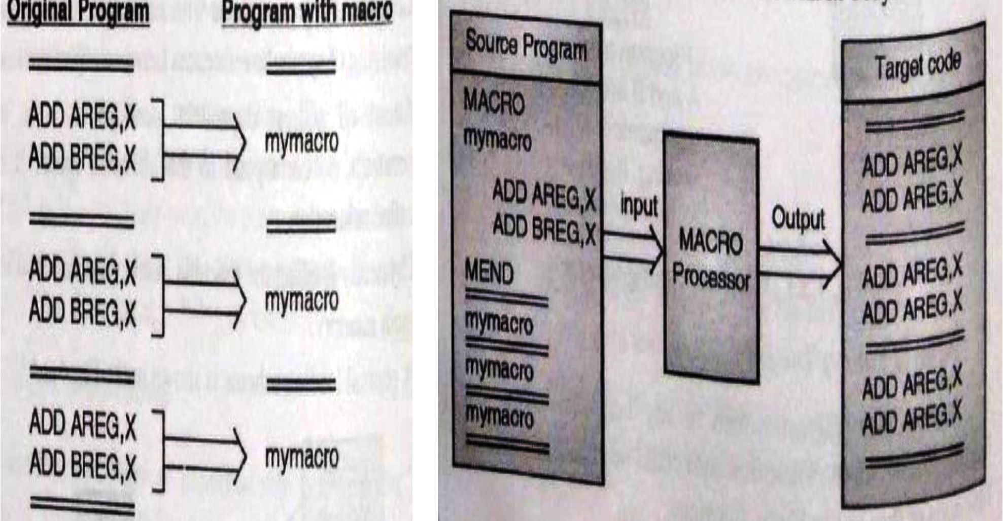
MACRO EXPANSION

Slide 25

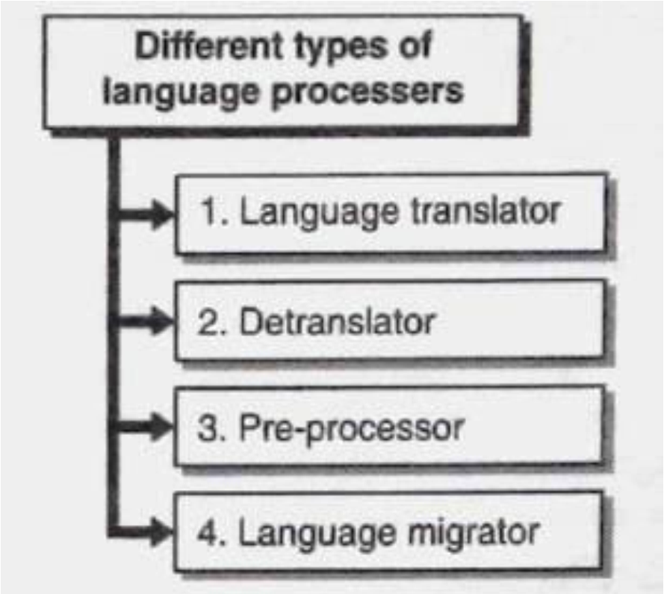
COMPILER

Slide 26
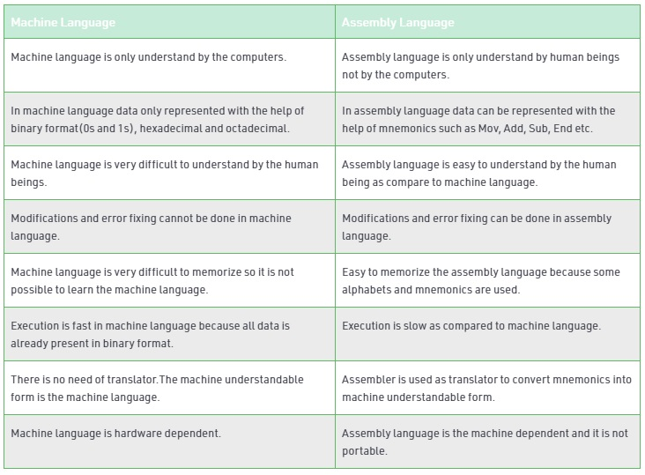
Assembly Language vs Machine Language

Slide 27
Assembly language statement format
[label] <opcode> <operand> [<operand>,….]
Ex: LOOP MOVER AREG,Y
ADD AREG,Y
Y DS 1

Slide 28
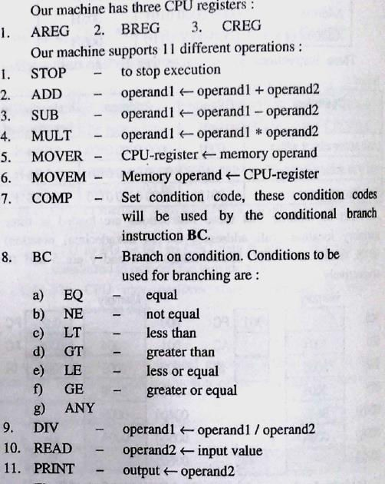
MACHINE LANGUAGE & ASSEMBLY LANGUAGE

Slide 29
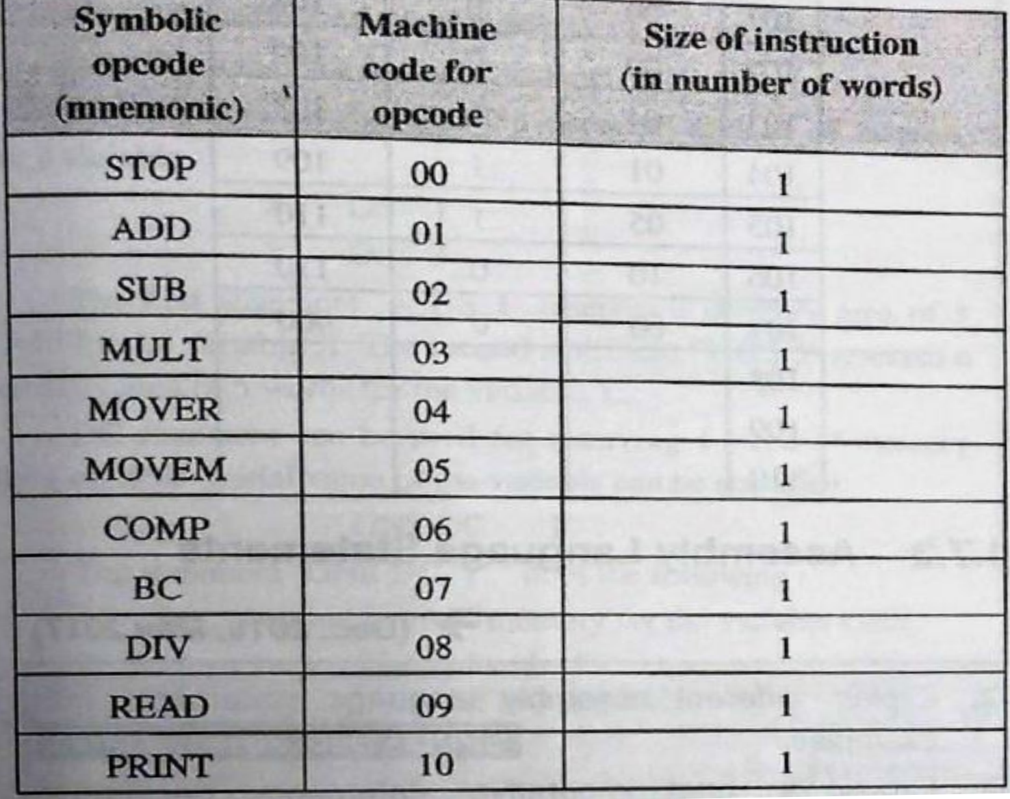
MACHINE OPCODE TABLE (MOT)

Slide 30
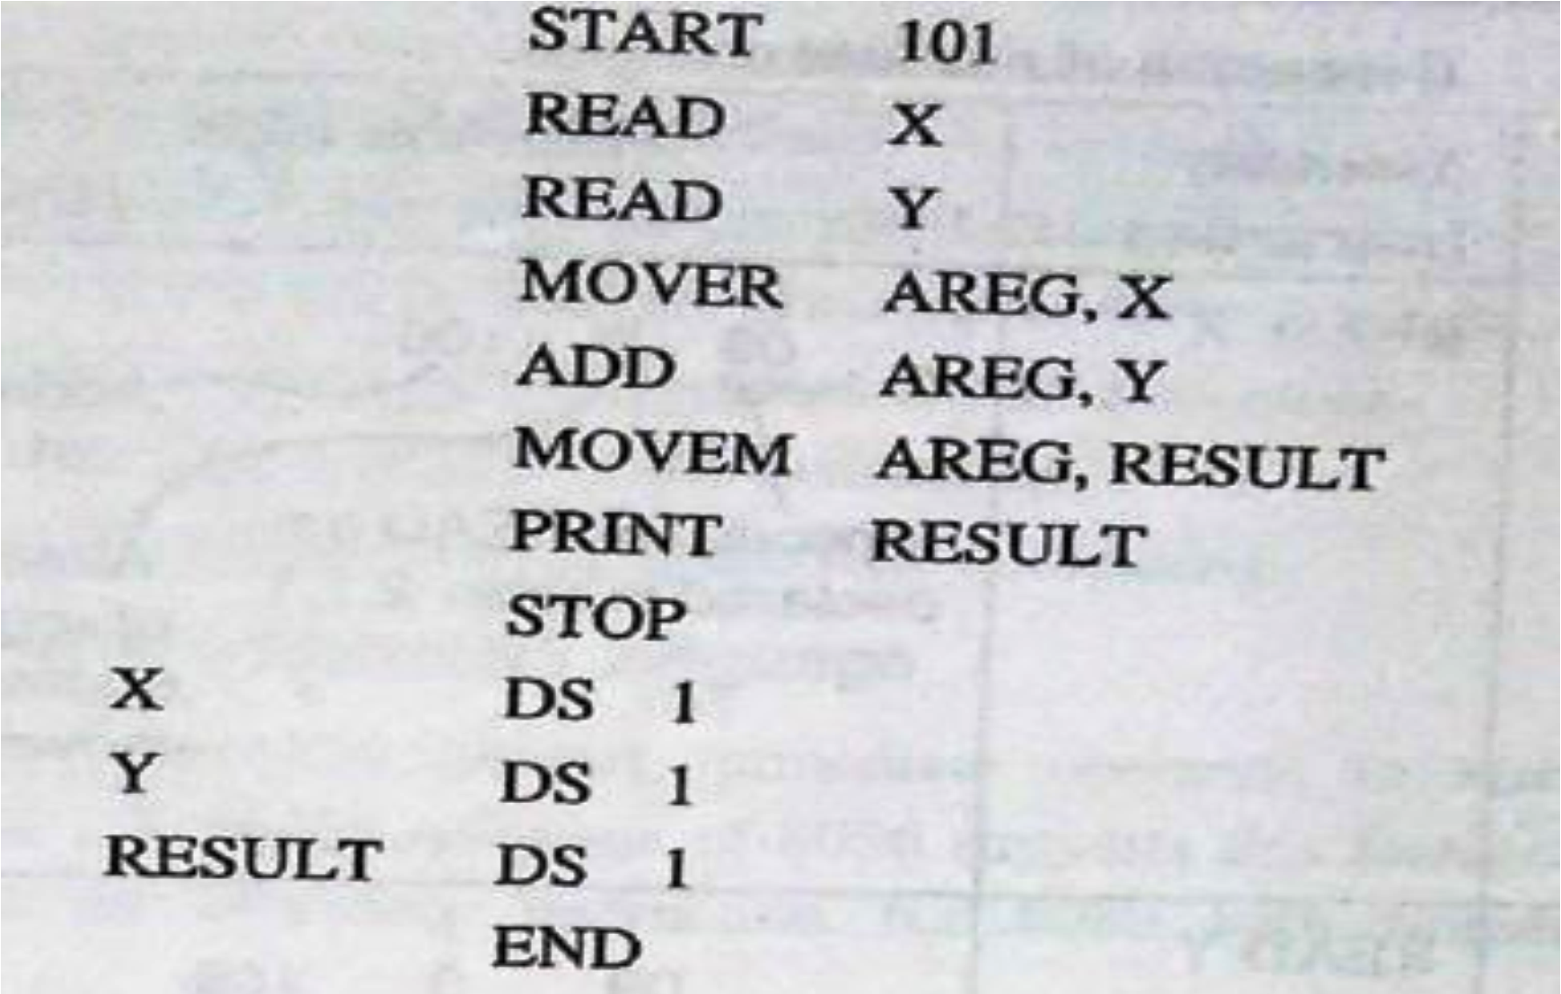
SAMPLE PROGRAM FOR FINDING X + Y

Slide 31
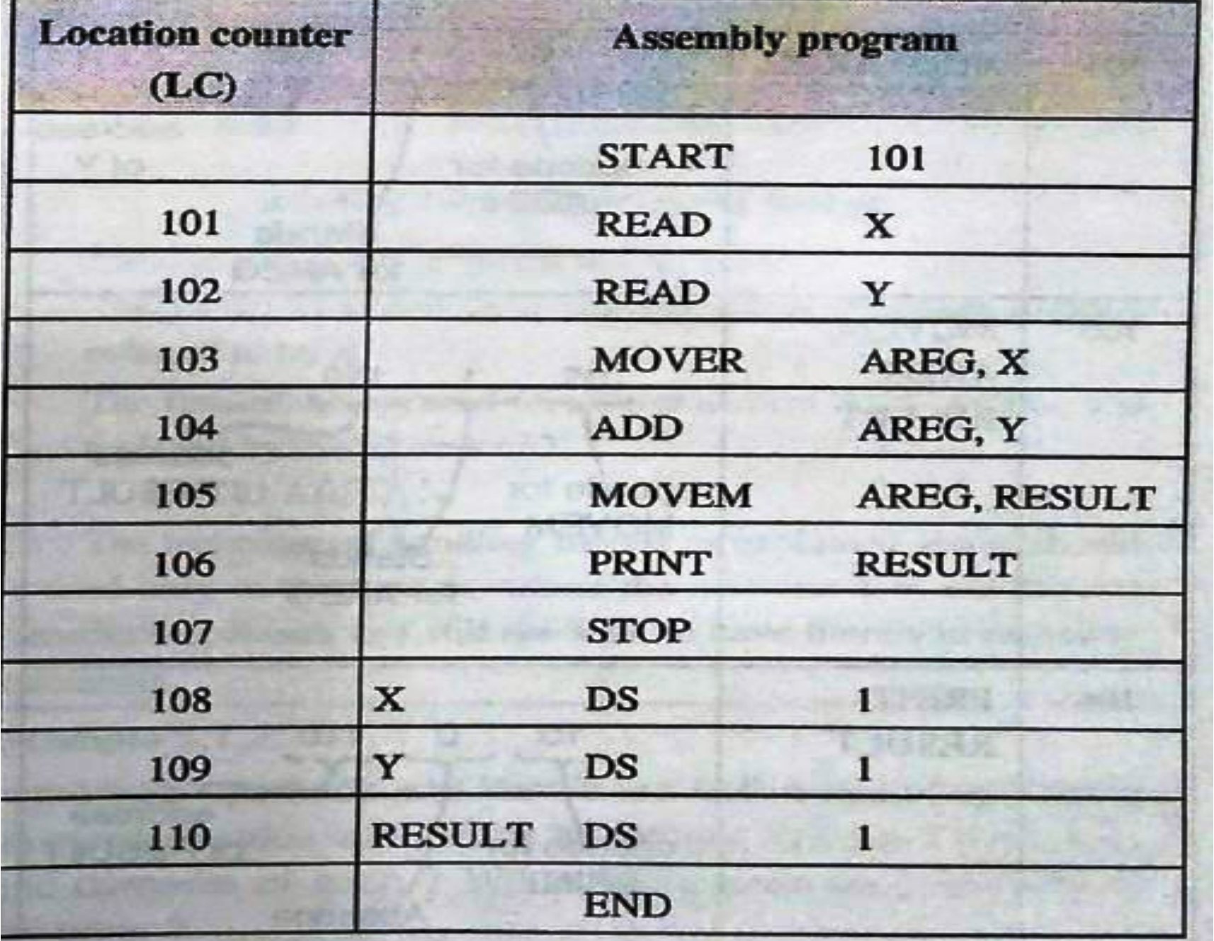
Program After updating LC

Slide 32
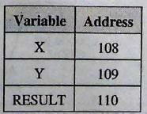
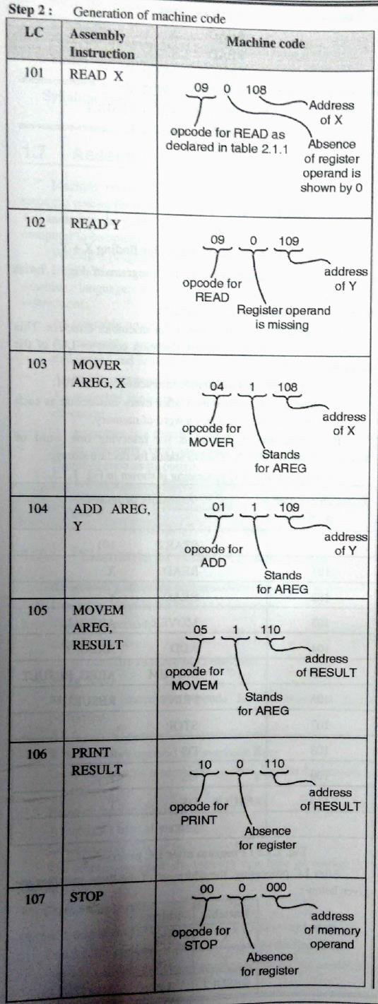

Slide 33
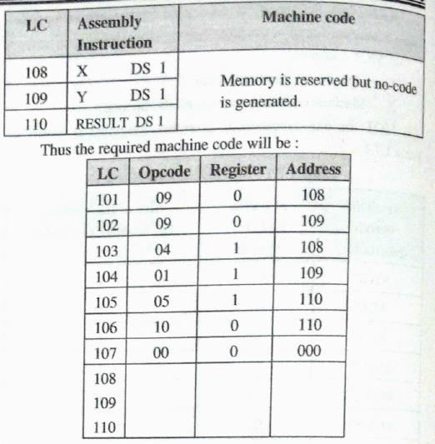

Slide 34
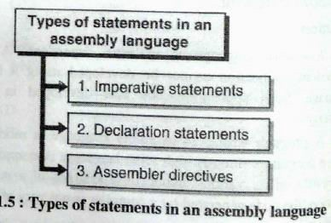
ASSEMBLY LANGUAGE STATEMENT

Slide 35
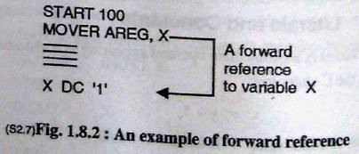
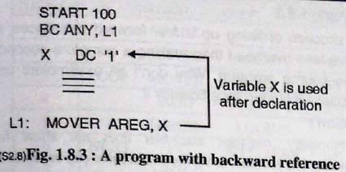
ONE PASS ASSEMBLER

Slide 36
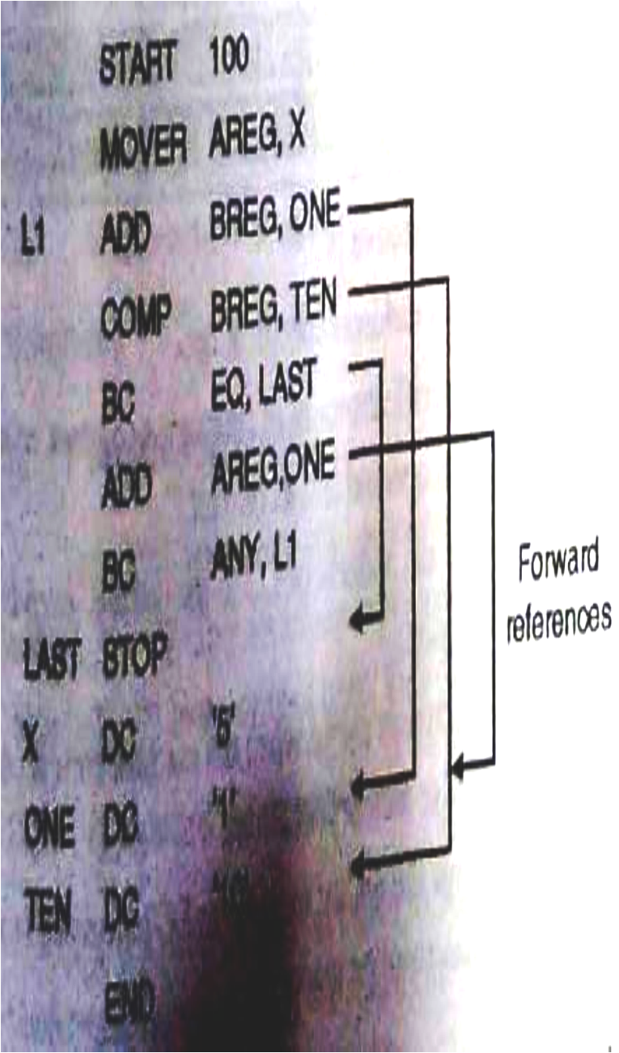
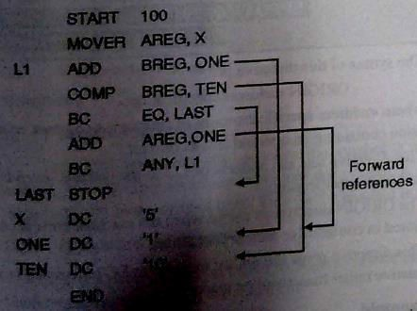
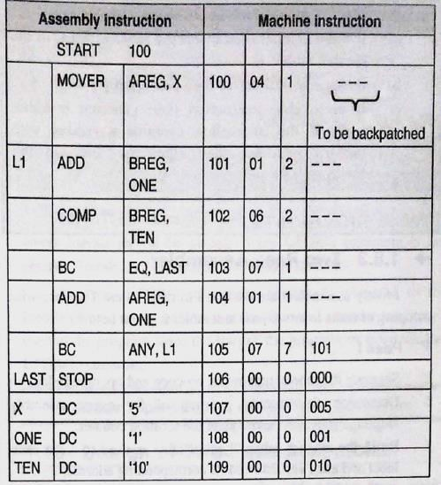
ONE PASS ASSEMBLER WITH FORWARD REFERENCES

Slide 37
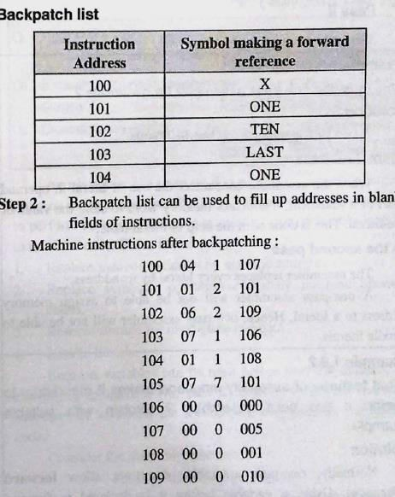

Slide 38
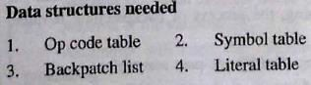
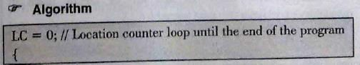
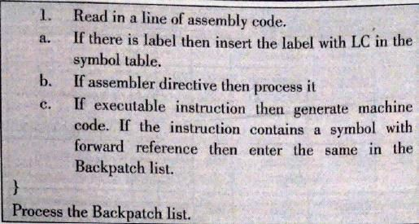
DESIGN OF SINGLE PASS ASSEMBLER

Slide 39
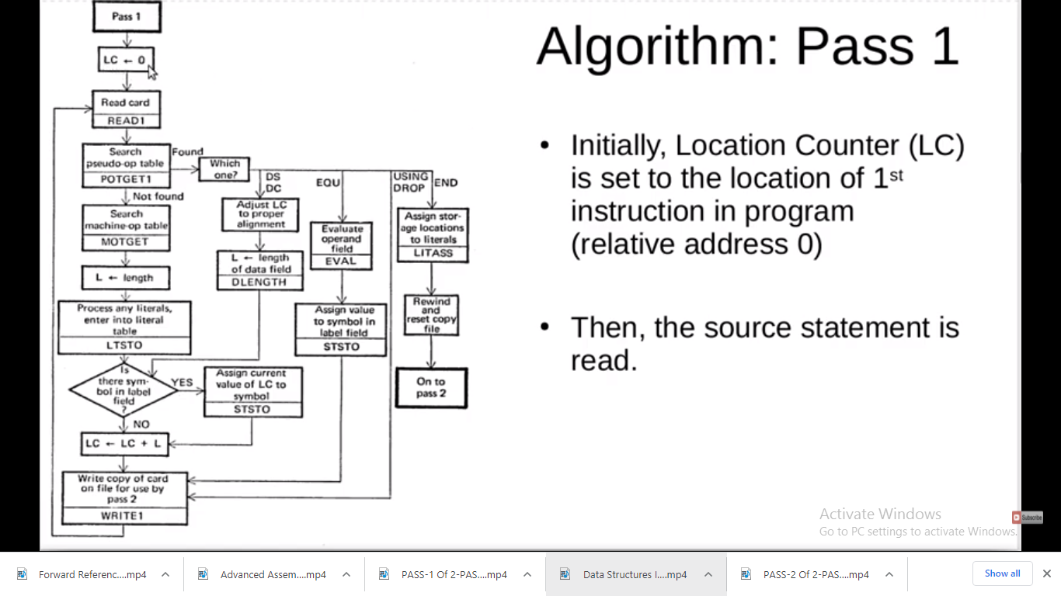

Slide 40
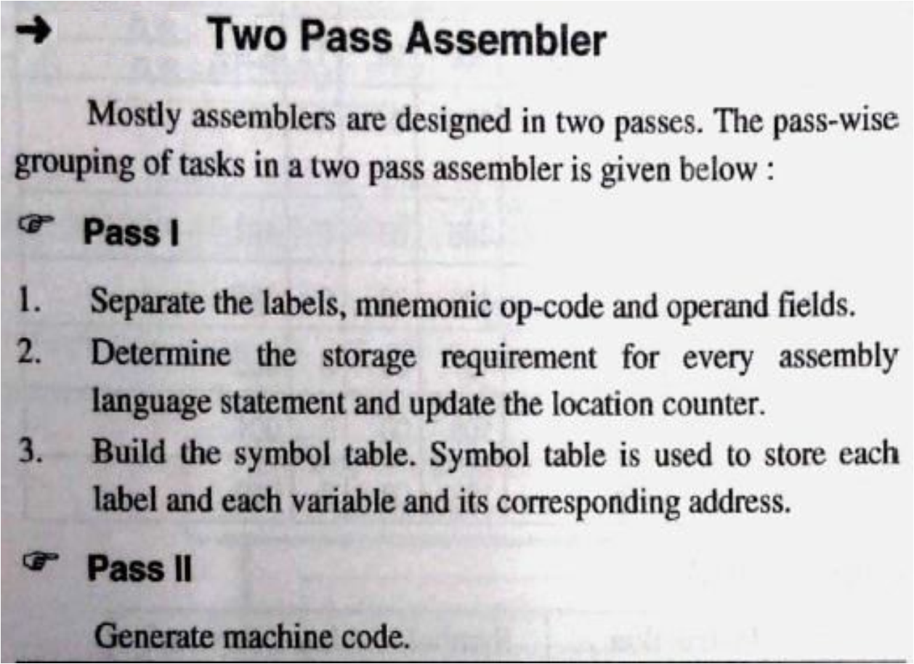

Slide 41
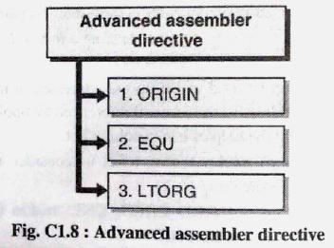
ADVANCED ASSEMBLER DIRECTIVES

Slide 42
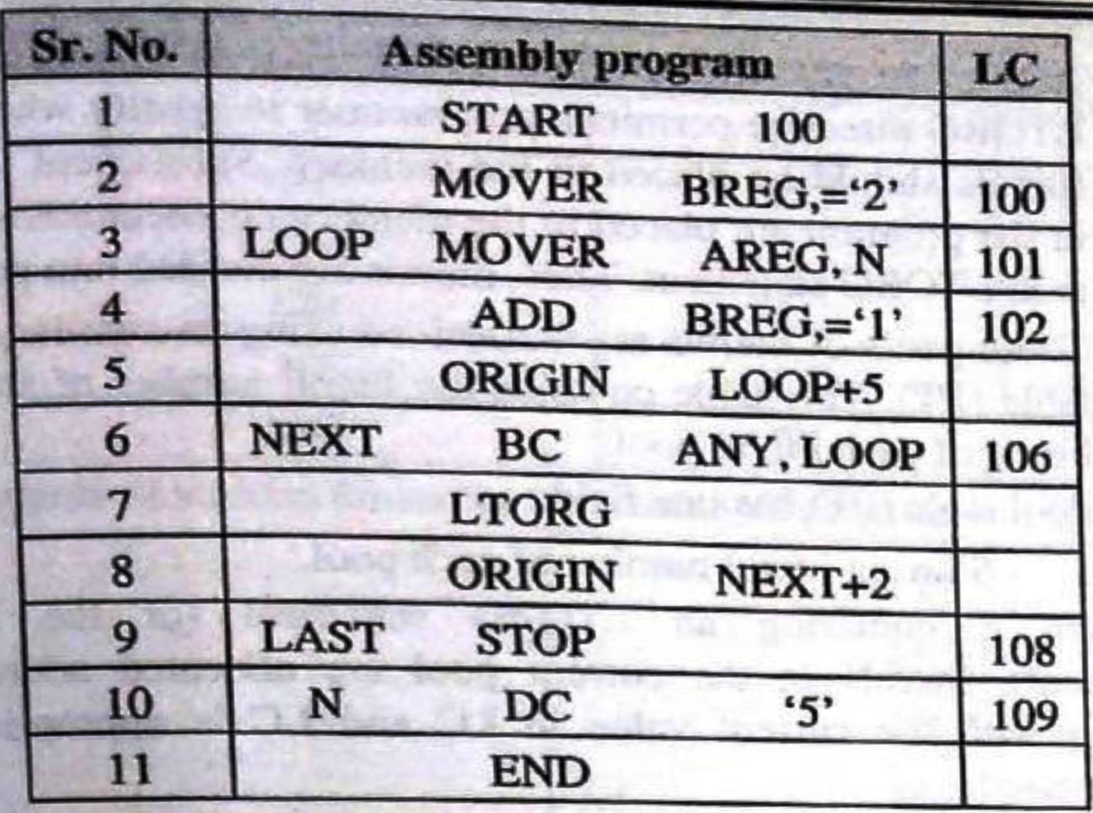

Slide 43
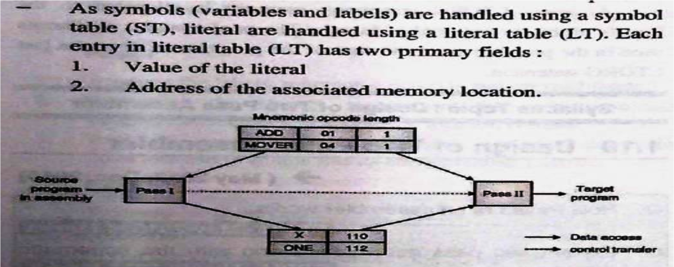
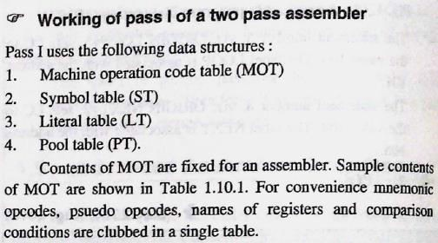
Design Of Two Pass Assembler

Slide 44
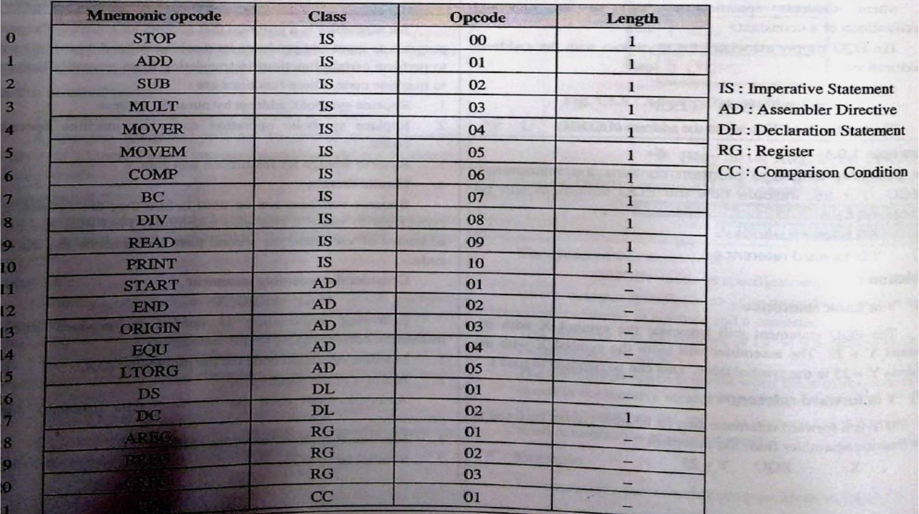
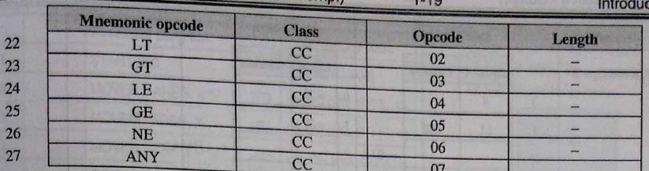

Slide 45
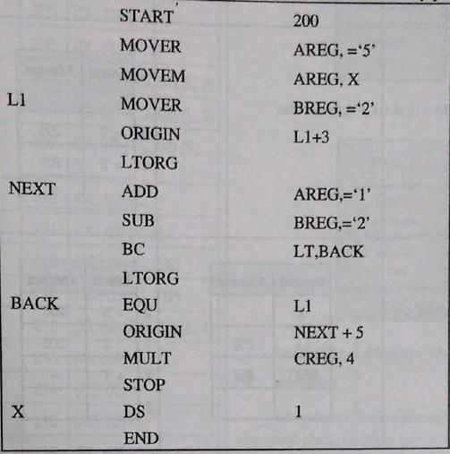
ASSEMBLY LANGUAGE PROGRAM FOR UNDERSTANDING PASS - 1

Slide 46
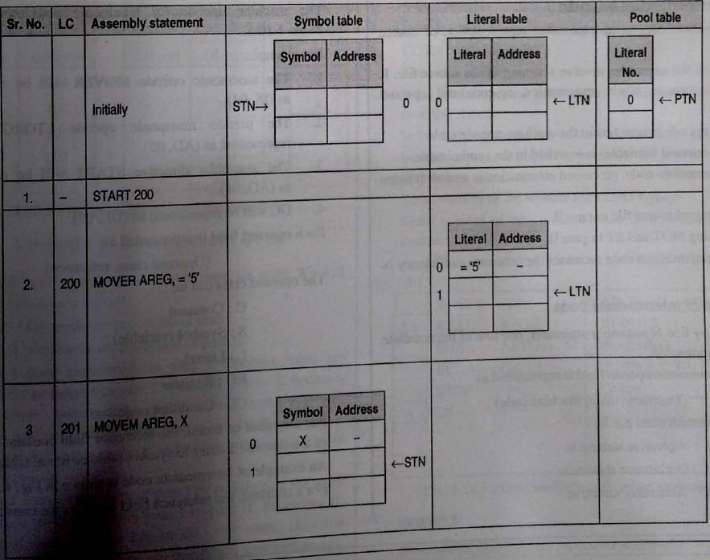

Slide 47
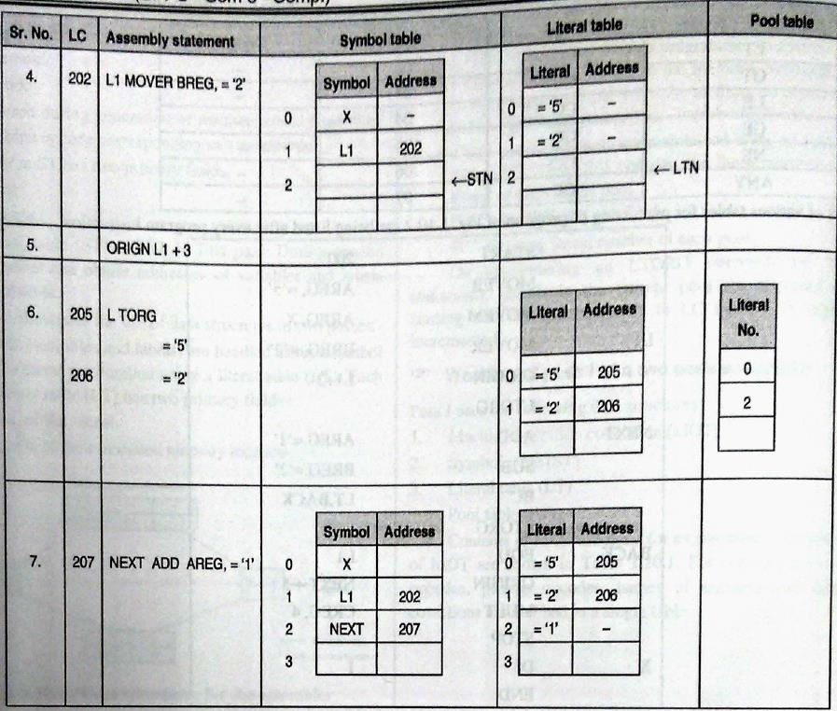

Slide 48
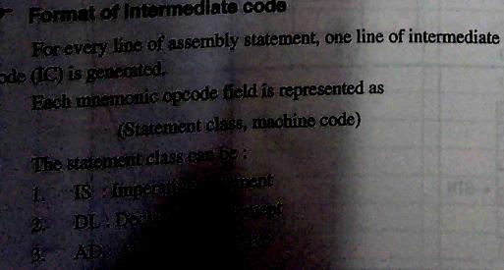
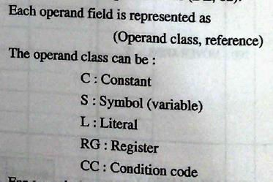
INTERMEDIATE CODE

Slide 49
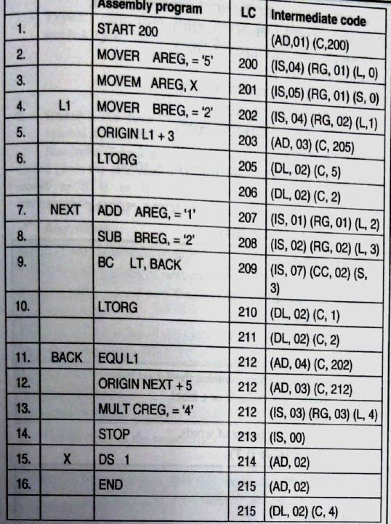

Slide 50
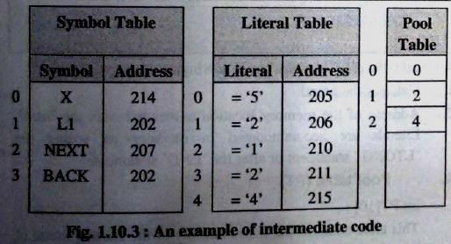
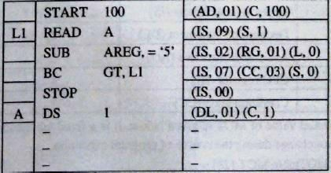
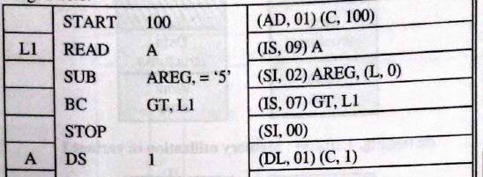

Slide 51
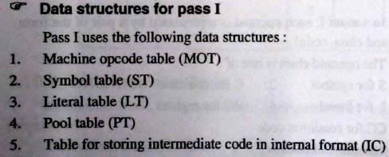
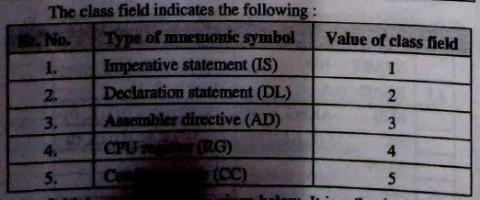

Slide 52
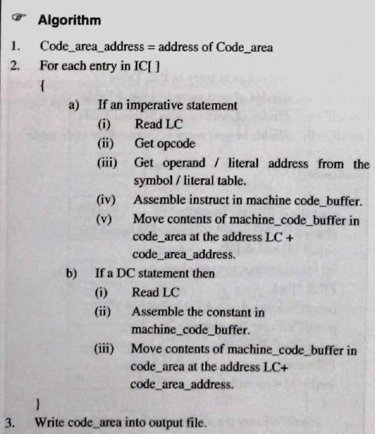
PASS-2 OF TWO PASS ASSEMBLER

Slide 53
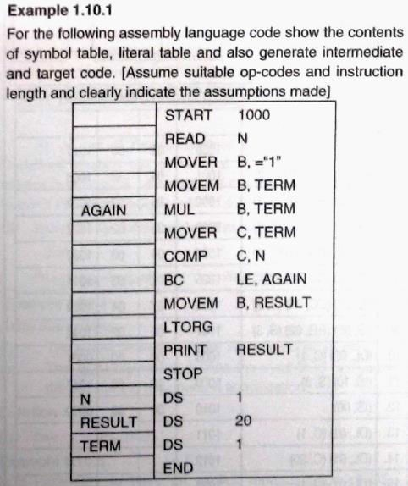

Slide 54


Slide 55



Slide 56


Slide 57


Slide 58


Slide 59



Formal System
A formal system is an un interpreted calculus.
It consists of
Alphabets
A set of words called Axioms.
Finite set of relations called rules of inference or
production rules.
Ex Boolean algebra.

Slide 60





Types of Assembly Language statements
Imperative statements
–An imperative statement in assembly language indicates the action to be performed during execution of assembly statement

Slide 61
Declarative Statement:-
– These statements declares the storage area or declares the constant in program.
– EX A DS 1
ONE DC “1”

Slide 62
Assembler Directives
– These are the statements used to indicate certain thing regarding how assembly of input program is to be performed.
– Ex START 100
USING *, 15

Slide 63




Types of Assembler
Single pass Assembler
Multi pass Assembler

Slide 64






Problem of Forward
Reference
When the variables are used before their definition at that time problem of forward reference accurse.

Slide 65





Problem of Forward
Reference
JOHN START 0
USING *, 15
L 1, FIVE A 1,FOUR ST 1, TEMP
DC F’4’
DC F’5
DS ’
FOUR FIVE TEMP
END 1F

Slide 66








General Design Procedure of Two Pass Assembler
Specify the problem
Specify data structures
Define format of data structures
Specify algorithm
Look for modularity [capability of one program to be subdivided into independent programming units.]
Repeat 1 through 5 on modules.

Slide 67






Step 2. Data structure:-
Pass1: Databases
Input source program
“LC” location counter used to keep track of each instructions addr.
M/c operation table (MOT) [Symbolic mnemonic & length]
Pseudo operation table [POT], [Symbolic mnemonic &
action]
Symbol Table (ST) to store each lable & it’s value.
Literal Table (LT), to store each literal (variable) &
it’s location.
Copy of input to used later by PASS-2.

Slide 68
Step 2. Data structure:-
Pass2: Databases
Copy of source program input to Pass1.
Location Counter (LC)
MOT [Mnemonic, length, binary m/c op code, etc.]
POT [Mnemonic & action to be taken in Pass2
ST [prepared by Pass1, label & value]
Base Table [or register table] indicates which registers are currently specified using ‘USING’ pseudo op & what are contents.
Literal table prepared by Pass1. [Lit name & value].

Slide 69
Thank You
1/4/2018
66

